Slide 1
Kubernetes
Networking
Notes:
1

Slide 2
Docker Networking
Bridge
None
Overlay
$ docker network create -d <type> name
host
Macvlan

Slide 3
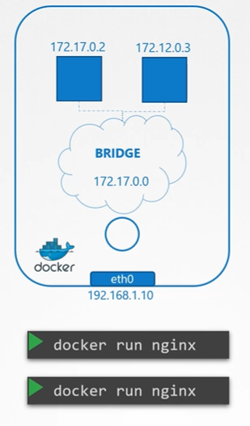
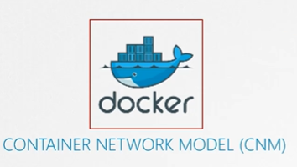
Docker Networking
Notes:
3

Slide 4
Kubernetes Networking Model
Every Pod has a unique IP
Pod IPs are routable/accessible from all the other pods,
regardless of which node they’re in
Notes:
4

Slide 5
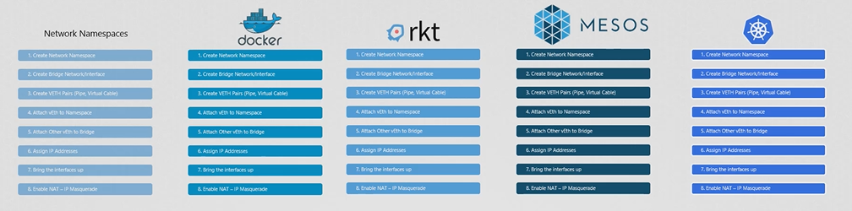
Container Networking Interface (CNI)
Notes:
5

Slide 6
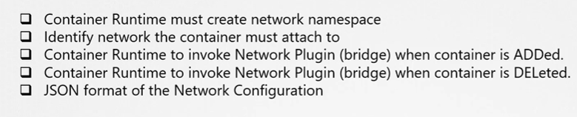

Kubernetes Networking Fundamental concepts
Notes:
6

Slide 7
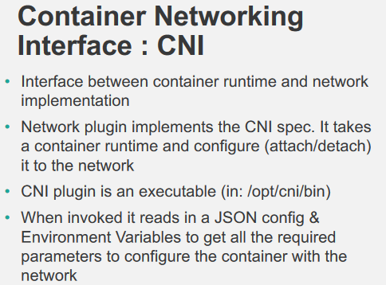
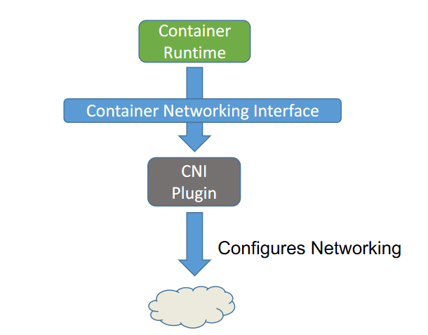
CNI

Slide 8
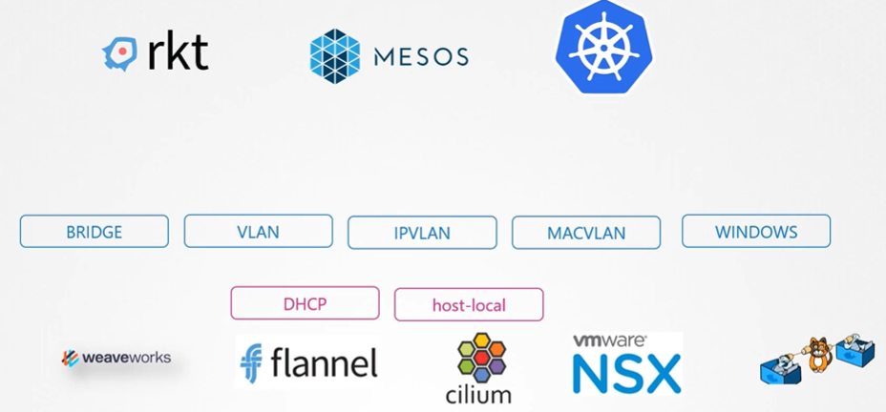
Kubernetes Networking Fundamental concepts
Notes:
8

Slide 9
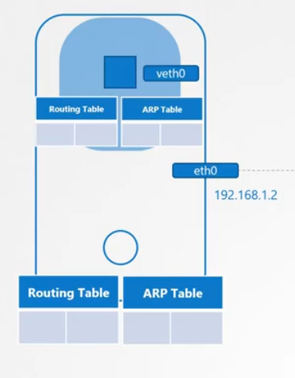
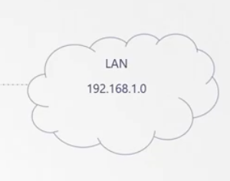
Container Networking
Namespaces can be connected using a Linux Virtual Ethernet Device or ’veth’ pair

Slide 10
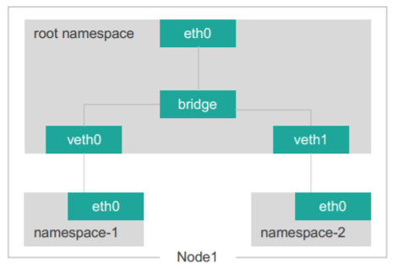
Linux Ethernet Bridge
Linux Ethernet bridge is a virtual Layer 2 networking device used to unite two or more network segments
Pods can talk to each other through the root namespace using Linux Ethernet Bridge
Ethernet bridge maintain a routing table and uses MAC-address unique to each Ethernet device in the network

Slide 11
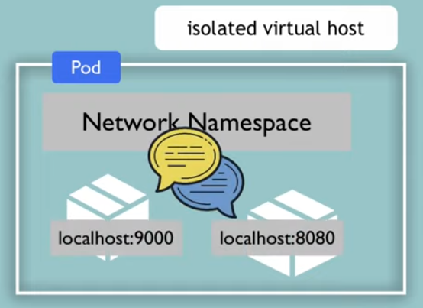
Intra-POD communication

Slide 12
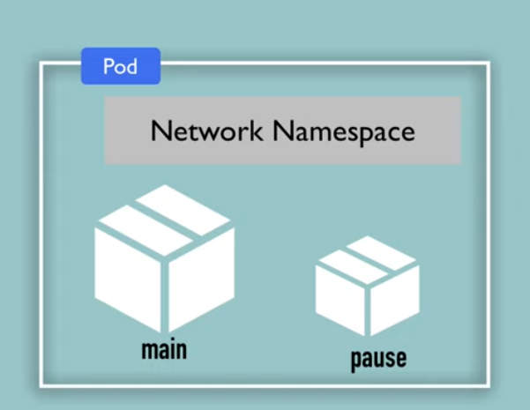
Intra-POD communication
Pod is comprised of one or more containers along with a “pause” container
Pause container responsibility is to bring up the network namespace. It reserves and holds network namespace

Slide 13
Intra-node communication
The main network interface eth0 is in this root netns
Every Pod has its own netns with a virtual ethernet pair connecting it to the root netns
Notes:
Communicate between Vethxx to Vethyy .. It is using a bridge.
Between PODs in a node, it uses L2
To talk to each other linux ethernet bridge cbr0
13

Slide 14
Inter-node communication
Notes:
14

Slide 15
Calico
Calico is a container networking solution which uses layer 3 to route packets to pods
Calico can also provide network policy for Kubernetes
Etcd is the backend data store for all the information Calico needs

Slide 16
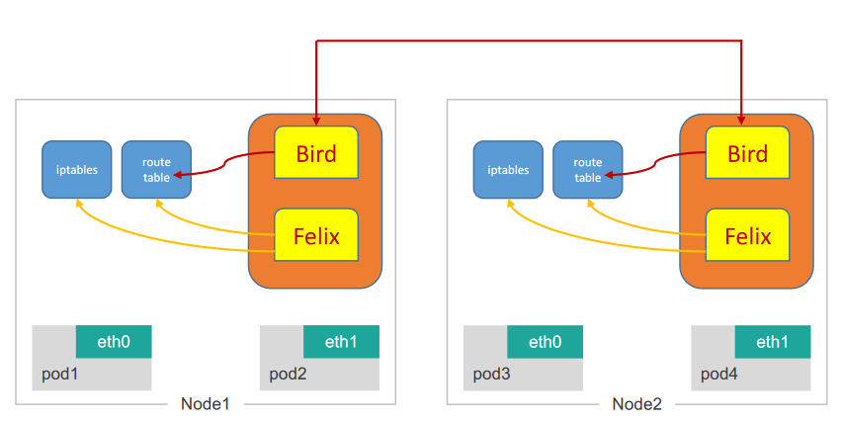
Calico Components
ETCD
BIRD
CONFD
FELIX
Notes:
CALICO-NODE runs as Daemonset in all nodes

Slide 17
ETCD
Etcd is the backend data store for all the information Calico needs
The default location for the calico keys is /calico

Slide 18

Felix

Slide 19
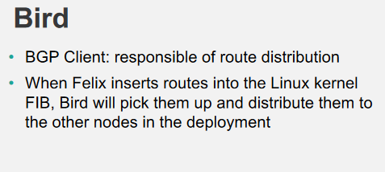
BIRD
BIRD is a BGP routing daemon which runs on every host.
Calico makes uses of BGP to propagate routes between hosts.
Bird runs on every host in the Kubernetes cluster, usually as a DaemonSet. It’s included in the calico/node container.

Slide 20
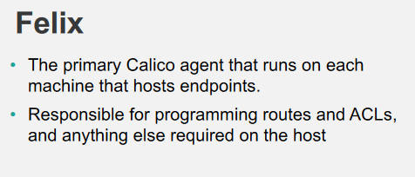
Calico Felix
Writes the routing table of the operating system
It manipulates IPtables on the host.

Slide 21
CONFD
Configuration management tool which reads values from etcd and writes the BIRD configuration for Calico

Slide 22
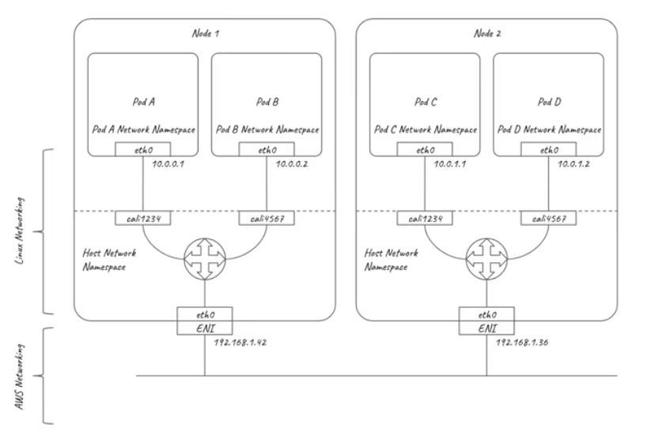
Kubernetes Networking

Slide 23
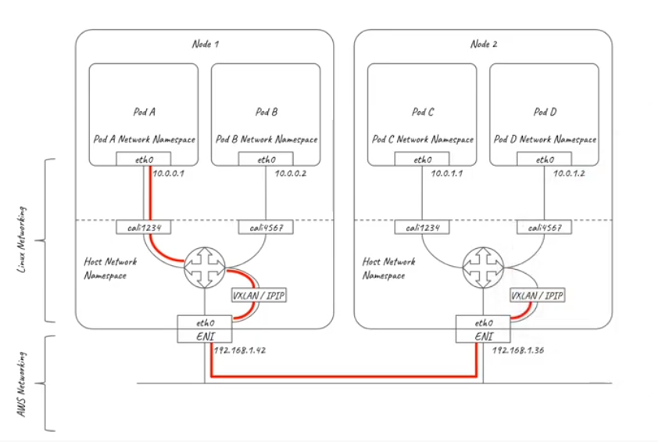
Kubernetes Networking

Slide 24
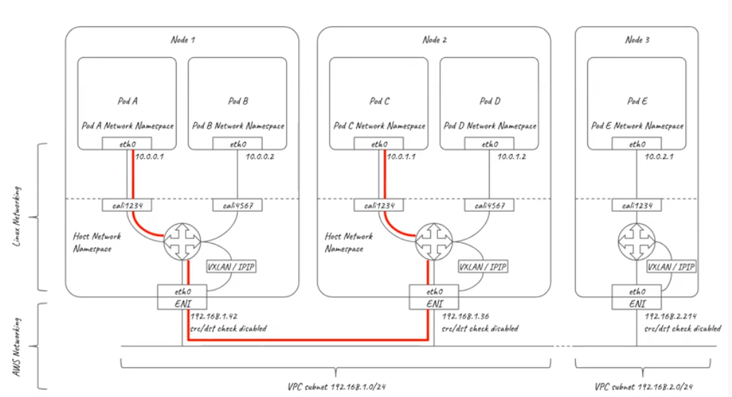
Kubernetes Networking

Slide 25
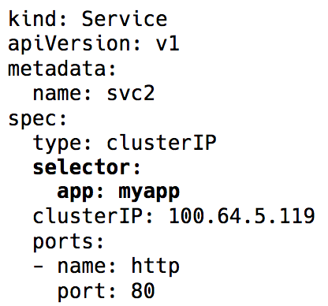
Service Networking
Pods (and consequently their IPs) change all the time. This makes the Pod IPs unreliable for using directly for communications.
Services — a virtual IP with a group of Pod IPs as endpoints (identified via label selectors)
Notes:
25

Slide 26
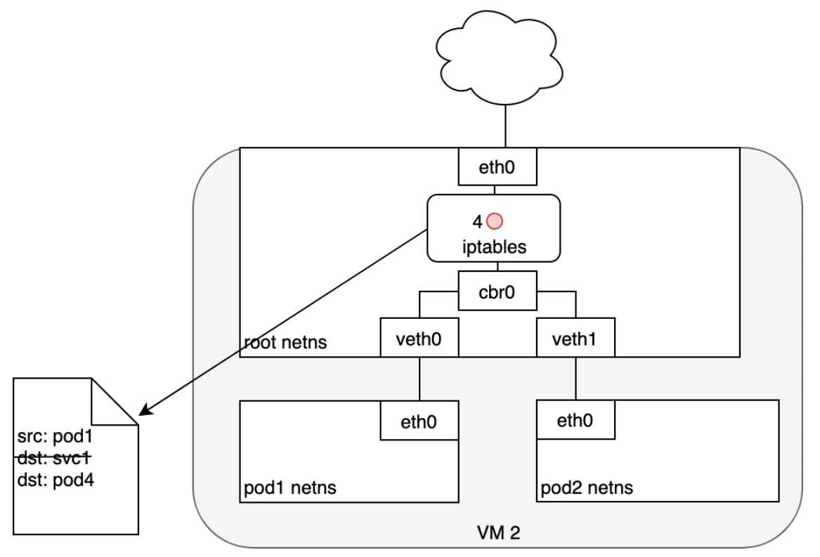
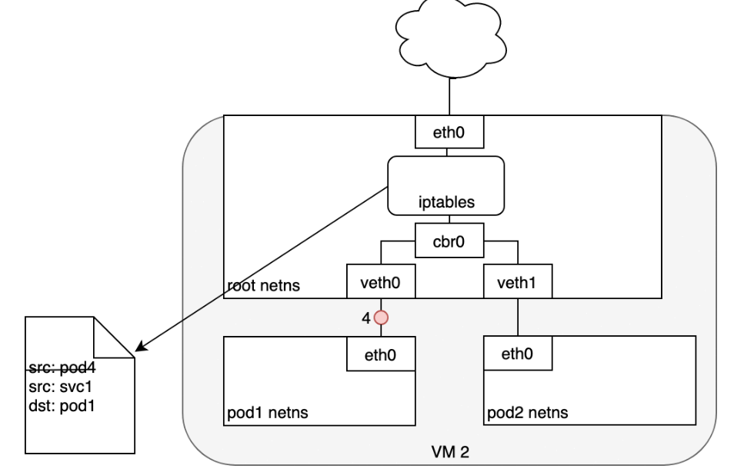
Service Networking
Notes:
26

Slide 27
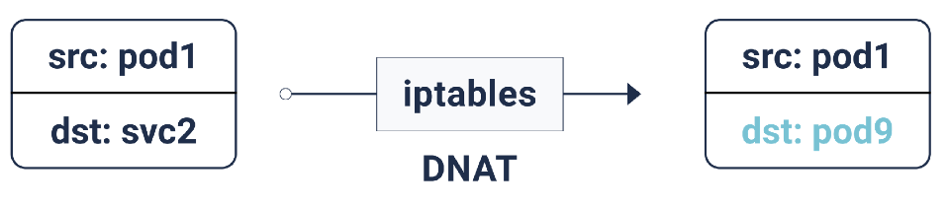
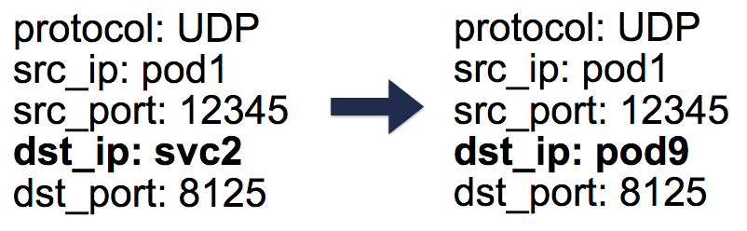
Service Networking
Virtual IP implementation (service) is actually iptables rules, that are managed by the KubeProxy
KubeProxy watches the api server for endpoints changes and updates the iptables rules accordingly
Linux connection tracking table
Notes:
27

Slide 28
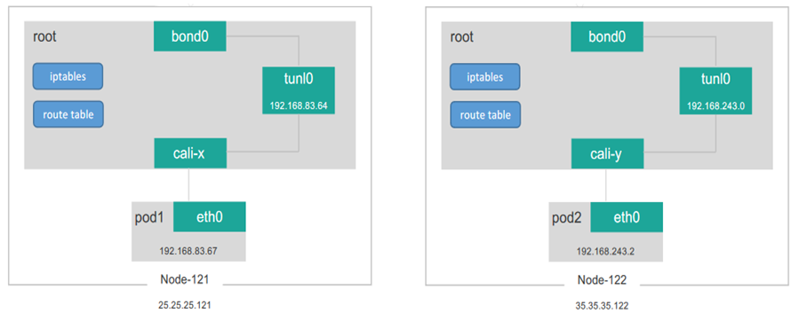
Calico Pod-to-Pod Communication

Slide 29
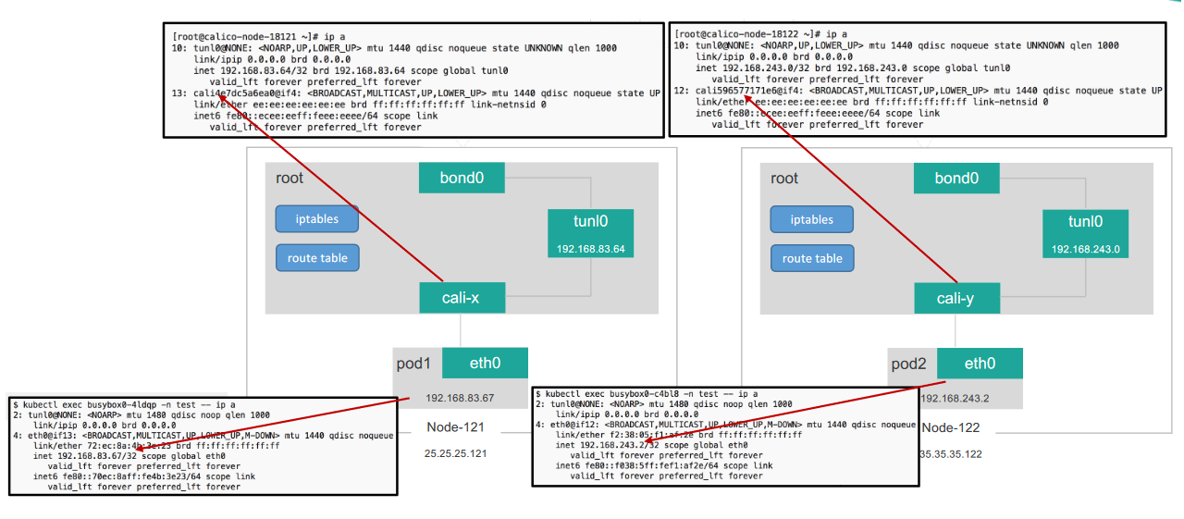
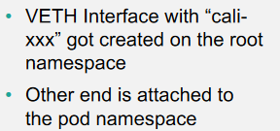
Pod-to-Pod Communication

Slide 30
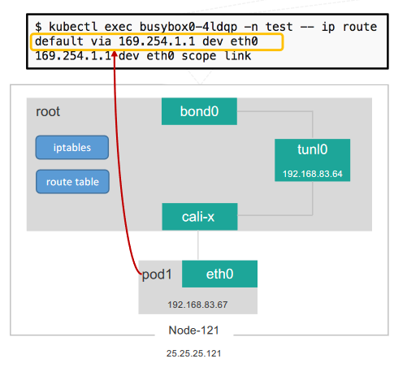
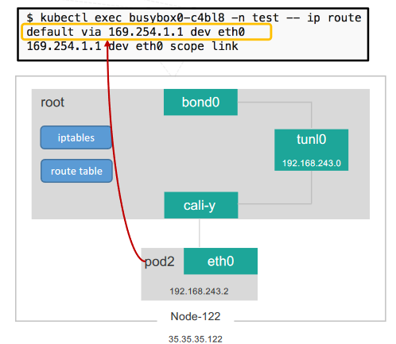
ARP Resolution

Slide 31
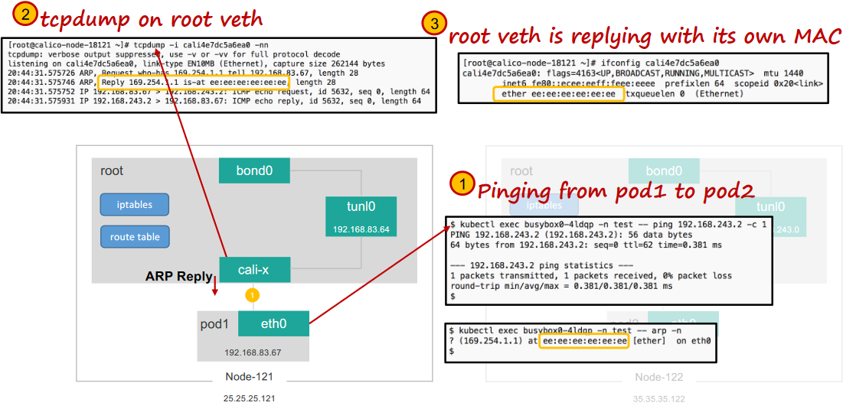
ARP Resolution

Slide 32
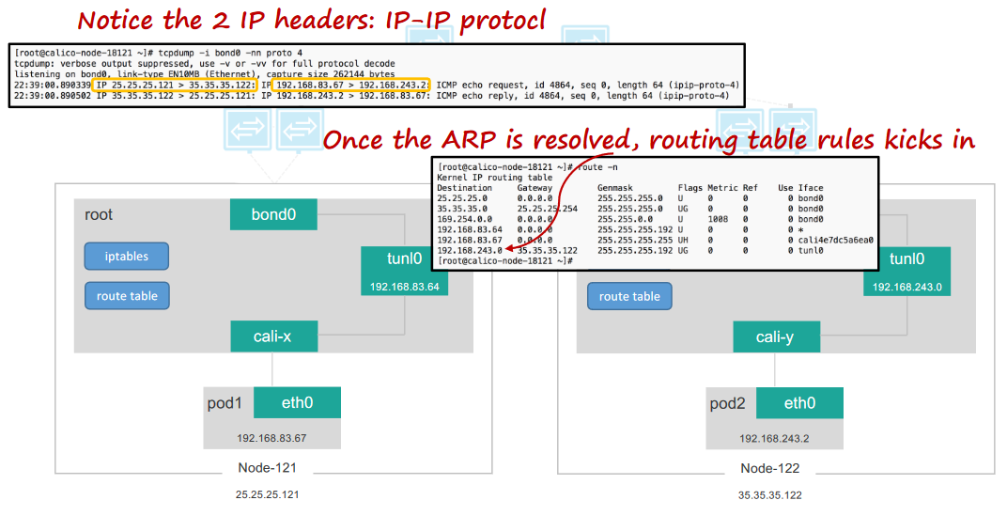
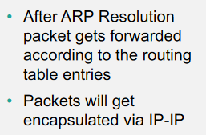
Packet Forwarding

Slide 33
Network Policy
To apply a NetworkPolicy definition in a Kubernetes cluster, the network plugin must support NetworkPolicy
For Exp:- Calico, Cilium, Kube-router, Romana, and Weave Net
The NetworkPolicy resource uses labels to determine which pods it will manage.

Slide 34
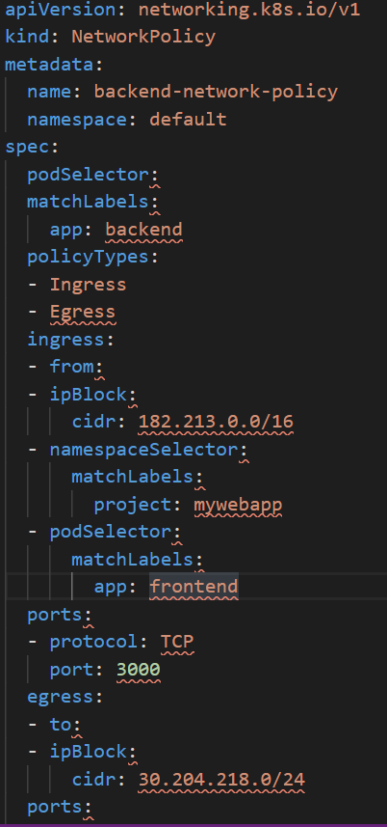
Network Policy
Example:-
Traffic is from IPs in block 182.213.0.0/16
The client pod is in a namespace that is labeled project=mywebapp.
The client pod is labeled app=frontend and it is in the same namespace (default).

Slide 35
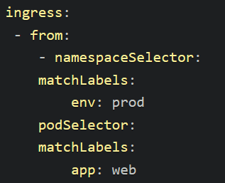
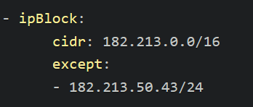
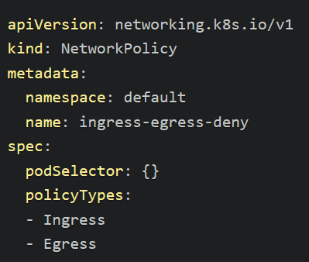
Network Policy – Fine Tuning
podSelector
namespaceSelector
ipBock
Deny all

Slide 36
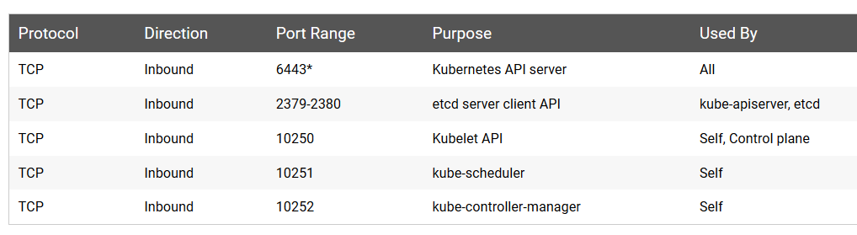
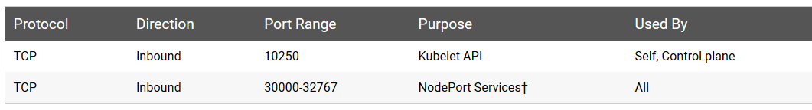
Kubernetes Cluster Networking
Control-plane node(s)
Worker nodes
Notes:
36

Slide 37
Kubernetes Logging
kubectl logs -f # stream logs
kubectl logs --since=1h # return logs newer than a relative duration
kubectl logs --since-time=2020-08-13T10:46:00.000000000Z # return logs after a specific date
kubectl logs --previous # print the logs for the previous instance of the container
kubectl logs -c # print the logs of this container
kubectl logs -l # print logs from all containers in pods defined by label
kubectl get events --sort-by=’.metadata.creationTimestamp’ # print all events in chronological order
kubectl describe pod # print pod details like status or recent events
Notes:
37

Slide 38
Kubernetes Logging
Node logging - /var/log/containers
System processes ( kubelet) - journalctl
Containers - /var/log
Notes:
38

Slide 39
Kubernetes Logging
Kubetail - Aggregate many pods into a single stream (https://github.com/johanhaleby/kubetail)
log aggregation - Supports logging agents for Elasticsearch, Google Stackdriver, Fluentd
(Agent deployed per node as a DaemonSet to collect all the logs on that node)
Using a sidecar for logging - Deploy a sidecar container alongside your application that will pick up the application logs and stream them to stdout and stderr respectively
DataDog, Dynatrace
Notes:
39

